Slide 1
Module-5: Data Analytics and Real-World Applications:
Exploratory Data Analysis (EDA): Data visualization techniques, Statistical analysis and hypothesis testing, Identifying patterns and insights from data.
Time Series Analysis: Introduction to time series data, Time series forecasting using ARIMA and Prophet, Evaluating time series models.
Integrating Machine Learning Models: Deployment of machine learning models, Building web applications with Flask and Django, Case studies on real-world applications of machine learning.

Slide 2
Exploratory Data Analysis:
Exploratory Data Analysis (EDA) is the process of analyzing, summarizing and explore datasets to:
Understand their structure
Find patterns, relationships, and anomalies
Prepare data for further modeling or decision-making
Goal of EDA:
“Let the data speak!” — Before building any model, understand what the data looks like.

Slide 3
Why is EDA Important?
Ensures data quality (no missing or wrong values)
Identifies patterns and trends
Detects outliers and noise
Helps choose the right machine learning model
Basic Steps in EDA:
Step | What You Do
1. Load the data | Use pandas, Excel, etc.
2. Understand the structure | Check rows, columns, types
3. Handle missing values | Remove or fill missing data
4. Summary statistics | Mean, median, min, max, std
5. Visualize the data | Use plots to explore patterns

Slide 4
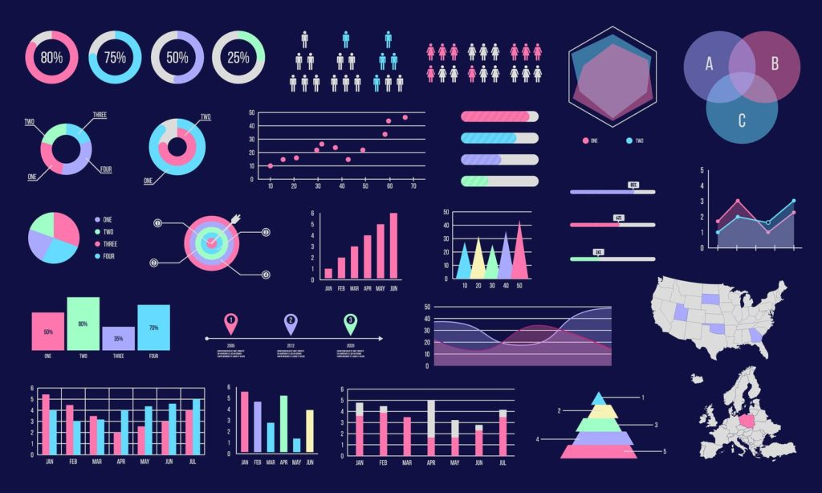
Numpy
Data
Matplotlib
Visualization

Slide 5
Data Visualization:
Data Visualization is the pictorial or graphical representation of data and information. It helps in identifying trends, patterns, and insights in large datasets by using visual elements like charts, graphs, maps, and dashboards.
Why is Data Visualization Important?
Better Data Understanding – Makes complex data easier to comprehend.
Identifies Trends and Patterns – Helps spot correlations and anomalies quickly.
Improves Decision Making – Supports data-driven business strategies.
Enhances Communication – Presents data effectively for both technical and non-technical audiences.

Slide 6
Popular Data Visualization Tools
Tableau
Power BI
Matplotlib & Seaborn (Python)
D3.js (JavaScript)
Google Data Studio

Slide 7
Data Visualization Techniques
Data Visualization Techniques are methods used to represent data graphically, making complex data more understandable and actionable. They help identify patterns, trends, and outliers in data by converting numerical and textual data into visual formats.

Slide 8
Common Data Visualization Types
Bar Chart – Compares different categories.
Line Chart – Shows trends over time.
Pie Chart – Represents proportions.
Scatter Plot – Displays relationships between variables.
Heatmap – Highlights data intensity with color variations.
Histogram – Represents frequency distribution.
Dashboard – Combines multiple visualizations for an overview.

Slide 9
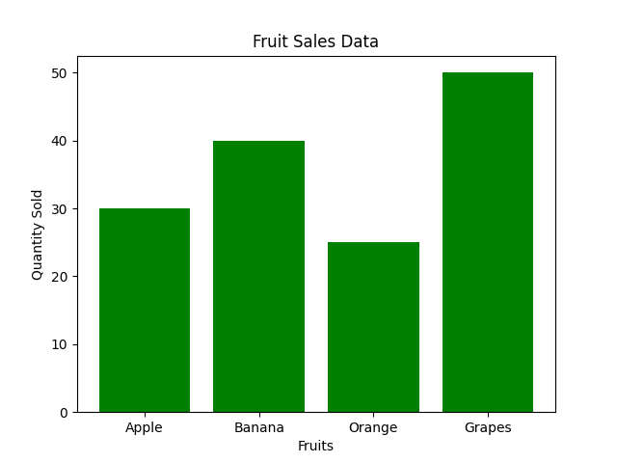
1. Bar Chart
Use: Compare quantities of different categories.
Example: Comparing sales across different regions.

Slide 10
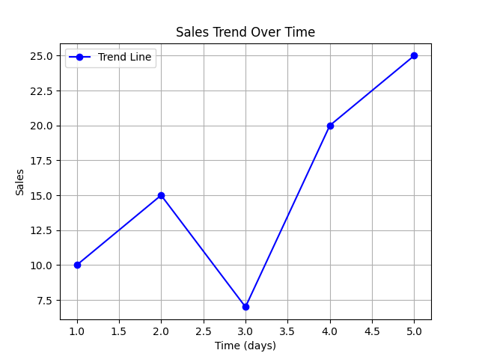
2. Line Chart
Use: Show trends over time (time series data).
Example: Sales Tred Over Time.

Slide 11
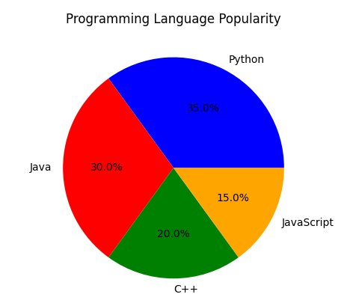
3. Pie Chart
Use: Show percentage or proportion of parts within a whole.
Example: Programming Language Popularity.

Slide 12
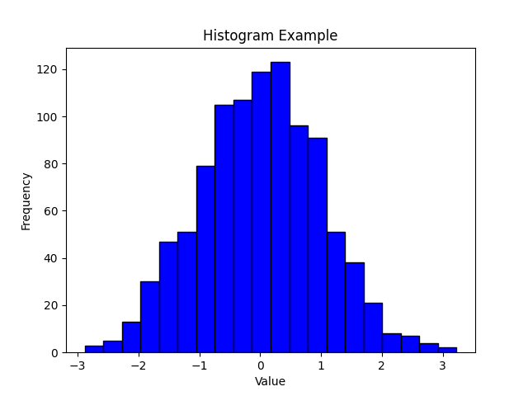
4. Histogram
Use: Show the distribution of numerical data.
Example: Exam scores of students.

Slide 13
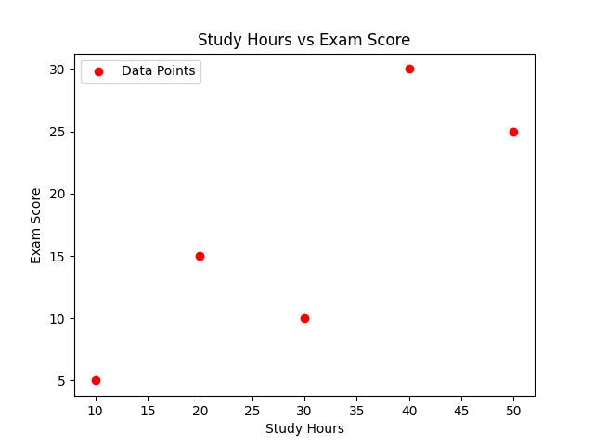
5. Scatter Plot
Use: Show correlation or relationship between two numeric variables.
Example: Hours studied vs. exam score.

Slide 14
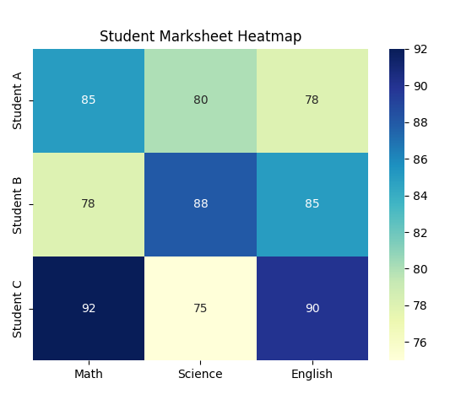
7. Heatmap
Use: Show values in a matrix using colors.
Example: Correlation matrix of variables.
What It Shows:
Grid view: subjects vs students
Colors show marks → darker = higher
Student C scored highest in Math & English

Slide 15
Statistical Analysis and Hypothesis Testing:
Statistical Analysis is the process of using math to understand patterns in data.
It helps in:
Understanding relationships between variables
Identifying trends, outliers, and distributions
Making predictions and decisions

Slide 16
Example:
Imagine you're teaching students, and you want to know:
Do students who study more hours get better scores?
You can collect data like:
Then you use statistical tools (like correlation) to check if more study hours = higher scores.
Hours Studied | Exam Score
1 | 40
2 | 55
3 | 60
5 | 75
6 | 80

Slide 17
What is Hypothesis Testing?
Hypothesis Testing is a way to test assumptions about a dataset.
It answers the question:
"Is what I'm seeing in the data real, or just due to chance?“
Term | Simple Meaning
Hypothesis | A guess/claim we want to test
Null Hypothesis (H₀) | "There is no effect or difference"
Alternate Hypothesis (H₁) | "There is an effect or difference"
P-value | Probability that results happened by chance
Significance level (α) | The cutoff (usually 0.05) to decide if we reject H₀

Slide 18
Example:
You built a new teaching method. You want to test if it really improves student scores.
H₀ (Null Hypothesis): New method has no effect.
H₁ (Alternate Hypothesis): New method improves scores.
You teach two groups:
Group A: Old method → Avg score = 70
Group B: New method → Avg score = 78
Now you do hypothesis testing to check:
👉 Is the difference (78 vs. 70) real or just by luck?
If p-value < 0.05 → Reject H₀
If p-value ≥ 0.05 → Don’t reject H₀

Slide 19
Why is Hypothesis Testing Important in ML?
In Machine Learning, we:
Test if one feature really affects the result
Decide if a new model is better than an old one
Avoid making decisions based on random patterns

Slide 20
Identifying patterns and insights from data
What does "Identifying Patterns and Insights" mean?
It means looking at data and finding useful information — things that repeat, stand out, or tell a story.
It’s like being a detective and using data as clues!
Why do we do this?
To answer questions like:
What is happening in the data?
Why is it happening?
What can we do based on it?

Slide 21
Real-life Examples:
1. Student Performance
Data: Marks of students in all subjects
Pattern: Most students who fail in Maths also score low in Physics
Insight: Students struggle with problem-solving subjects
Action: Plan extra problem-solving sessions
2. Online Shopping
Data: Products people buy
Pattern: People who buy laptops also buy laptop bags
Insight: There’s a link between these two products
Action: Show laptop bags as “suggested items”

Slide 22
How do we identify patterns?
1. Data Visualization
Graphs help us see patterns clearly
Bar charts → Which category is most common?
Line charts → What’s increasing or decreasing over time?
Heatmaps → Where are values strong or weak?
2. Statistical Measures
Mean / Median / Mode → Find central values
Correlation → See if two things rise/fall together e.g., More hours studied = Higher marks?

Slide 23
3. Clustering
Group similar data together E.g., Segment customers into groups based on age & spending.
4. Anomaly Detection
Spot unusual data E.g., A sudden drop in website traffic

Slide 24
Introduction to Time Series Data:
Time Series Data is a collection of data points collected over time – usually at regular intervals like daily, weekly, monthly, or yearly.
It helps us see how things change over time.
Each data point is associated with a timestamp (date/time).
Examples of Time Series Data
Example | Time Interval
Daily temperature of a city | Every day
Stock prices of a company | Every second/minute/hour/day
Monthly rainfall in a region | Every month
Electricity usage in a home | Every hour
COVID-19 cases reported daily | Every day

Slide 25
Components of Time Series Data
Trend – Long-term movement (📈 sales going up)
Seasonality – Repeating patterns (🌦 rainy season every year)
Cyclic patterns – Up & down cycles over years (📉 economic cycles)
Noise – Random or irregular variations (📉 sudden stock drop)
Time Series Terminology
Term | Meaning
Timestamp | The date/time of each data point
Frequency | How often data is recorded (daily, hourly, etc.)
Lag | Time gap between data points (e.g., 1 day ago)
Forecast | Predicting future data values

Slide 26
Note:
Think of a time series as a story told over time, where each data point is a chapter that helps us understand what happened before and predict what may happen next.

Slide 27
Time Series Analysis:
Time Series Analysis is the process of:
“Studying time-based data to understand what happened in the past and make predictions about the future.”
It focuses on:
Trends (Is it going up or down?)
Patterns (Is it repeating?)
Forecasting (What might happen next?)

Slide 28
Time Series Forecasting using ARIMA and Prophet:
What is Time Series Forecasting?
Forecasting means predicting future values based on past data.
Example:
Predicting next month’s sales
Estimating future temperature
Forecasting stock prices

Slide 29
Two Popular Forecasting Models:
ARIMA (AutoRegressive Integrated Moving Average)
Prophet (By Facebook/Meta)

Slide 30
ARIMA (AutoRegressive Integrated Moving Average)
What is ARIMA?
ARIMA is a classic statistical model that uses past values and patterns to predict future values.
ARIMA is made of 3 parts:
Part | Meaning
AR (AutoRegressive) | Uses past values to predict future ones (like yesterday’s sales)
I (Integrated) | Makes the data stable by removing trends (called differencing)
MA (Moving Average) | Uses past errors (differences between predicted & actual values)

Slide 31
Example:
If you know:
Sales 3 days ago: 100
2 days ago: 110
Yesterday: 120
ARIMA uses this pattern to predict today’s sales.
Best For:
Clean, numeric time series
When you want accuracy + control

Slide 32
Prophet (By Facebook/Meta)
What is Prophet?
Prophet is a modern forecasting tool built by Facebook, designed to be:
Simple to use
Great at handling seasonality and holidays
Prophet Model Components:
Component | Meaning
Trend | Overall direction (up/down over time)
Seasonality | Repeating patterns (daily, weekly, yearly)
Holidays | Special events that affect the data (e.g., Diwali sales)

Slide 33
ARIMA vs Prophet – Which One to Use?
Feature | ARIMA | Prophet
Easy to use | Needs tuning | Very beginner-friendly
Handles seasonality | Not automatic | Automatic
Handles holidays | Not directly | Yes
Accuracy | High (with tuning) | Good
Use in industry | Finance, engineering | Business, marketing, weather

Slide 34
Evaluating time series models:
After we build a time series model (like ARIMA or Prophet), we need to check how good the predictions are. This process is called model evaluation.
Why Do We Evaluate?
To know how accurate our forecasts are.
To compare different models and choose the best one.
To improve our model by finding where it's going wrong.
Note: The metrics used to evaluate time series forecasting models like ARIMA or Prophet are very similar to those used in supervised regression models in machine learning.

Slide 35
Model evaluation metrics for Time Series Data:
MAE (Mean Absolute Error)
MSE (Mean Squared Error)
RMSE (Root Mean Squared Error)
These are commonly used to evaluate regression models, where the goal is to predict continuous values (e.g., predicting house prices, temperatures, etc.).

Slide 36
Deployment of machine learning models:
What is Deployment?
Deployment means taking a machine learning model from your computer and making it available for real-world use, like in a website, app, or business system.
You train a model → It works → You deploy it → Users can use it!
Example:
You build a model to:
Predict product sales
Detect traffic from cameras
Diagnose disease from symptoms
After training the model, deployment means:
Making this model available online so that other apps or users can send data and get predictions in real time.

Slide 37
Building web applications with Flask and Django:
What is a Web Application?
A web application is a program that runs in a web browser and allows users to interact with it online.
Example:
E-commerce website
Online quiz app
Student attendance portal

Slide 38
Building Web Apps with Flask:
Flask is a lightweight web framework written in Python that helps you build web applications quickly and easily.
Key Points:
Known as a "micro-framework" — minimal by default, but you can add what you need.
Great for small to medium web apps.
Gives you more control and flexibility.
Easy to learn — perfect for beginners.
Flask includes:
A built-in web server
A simple way to define routes (URLs)
A template engine (Jinja2) to render HTML pages

Slide 39

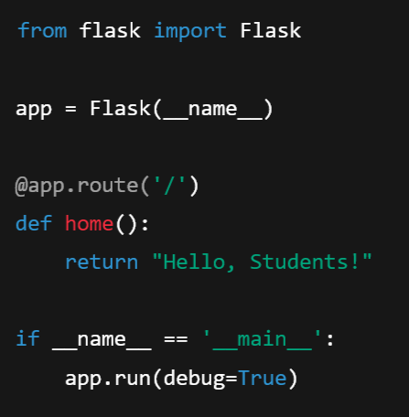
Simple Flask Server:
Step 1: Install Flask
Step 2: Create a Basic Flask App
Now visit: http://localhost:5000
You’ll see "Hello, Students!"

Slide 40
Building Web Apps with Django:
Django is a high-level web framework for Python that helps you build powerful web applications quickly with less code.
Key Points:
Known as a "batteries-included" framework — comes with everything you need.
Great for large and complex apps.
Built-in tools for:
Authentication (login/register)
Admin panel
Database handling
Security
Django includes:
ORM (Object Relational Mapping) for database access
Admin interface (auto-generated)
URL routing, templates, and forms
Security features

Slide 41

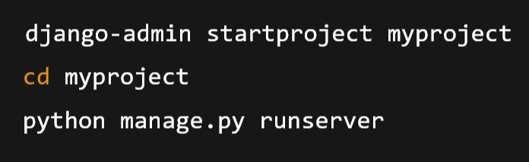
Simple Django Server:
Step 1: Install Django
Step 2: Create a New Project and Visit: http://localhost:8000 — Django is running!

Slide 42

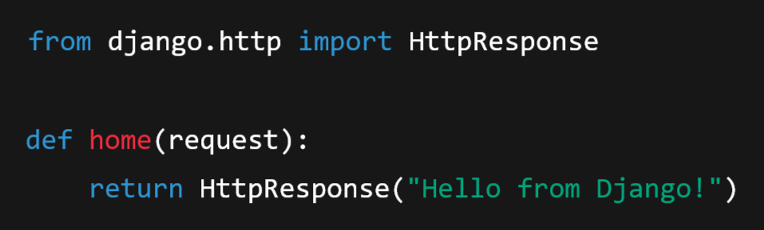
Step 3: Create an App
Add your app to INSTALLED_APPS in settings.py
Define routes (views), templates, and models
Step 4: Add Views and Templates
views.py

Slide 43
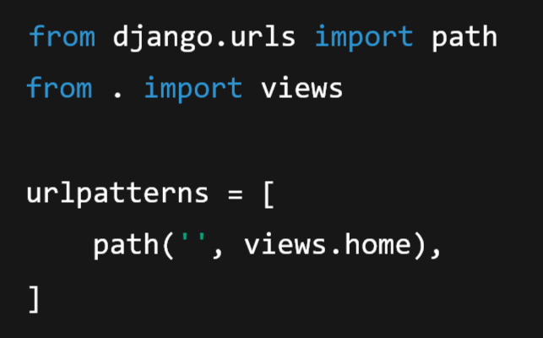
urls.py

Slide 44
Case Studies on Real-World Applications of Machine Learning

Slide 45
What is a Case Study?
A case study is a detailed investigation or analysis of a real-life problem or project to understand how a concept or method is applied in practice.
In Simple Terms:
A case study tells a story of a real situation where something like machine learning, AI, or a business strategy was used to solve a problem.

Slide 46
Case Study:
Case Study 1: Predicting Movie Preferences (Netflix)
Case Study 2: Product Recommendations (Amazon)
Case Study 3: Self-Driving Cars (Tesla)
Case Study 4: Disease Prediction (Healthcare)
Case Study 5: Face Recognition (Facebook/Meta)
Case Study 6: Fraud Detection (Banks & FinTech)
Case Study 7: Voice Assistants (Siri, Alexa, Google Assistant)

Slide 47
Module-5: Data Analytics and Real-World Applications:
Exploratory Data Analysis (EDA): Data visualization techniques, Statistical analysis and hypothesis testing, Identifying patterns and insights from data.
Time Series Analysis: Introduction to time series data, Time series forecasting using ARIMA and Prophet, Evaluating time series models.
Integrating Machine Learning Models: Deployment of machine learning models, Building web applications with Flask and Django, Case studies on real-world applications of machine learning.

